Slide 1


MAVERICKS HACKATHON PROGRAM
2026
INNOVISTA

Slide 2


INNOVISTA
SKILLARISE
TEAM MEMBERS :
RESHIK RABACCA A-[AIDS]
SWETHA R-[CSBS]
AMIRTHA LAKSHMI S V-[CSBS]
MONIFA PRISCA T-[ECE]

Slide 3


Impact/Potential Value of the Application
SkillArise has the potential to transform personalized learning and career development by offering a comprehensive platform that intelligently assesses user skills, uncovers learning gaps, and delivers custom learning paths. With features like smart resume parsing, adaptive skill quizzes, and curated roadmaps, it enables users to take charge of their upskilling journey. The platform’s integration of mock interviews, soft skill analysis, gamified learning modules, and social learning guilds supports holistic growth—both technical and interpersonal. Especially suited for students, job seekers, and working professionals, SkillArise provides a scalable, intelligent, and engaging ecosystem that prepares users for success in today’s dynamic job market.

Slide 4

The Solution Proposed
Solution Highlights:
Unified platform for skill assessment ,learning and interview readiness.
AI-powered personalization based on resume and performance.
Gamified experience with XP, badges, and progress tracking.
Prepares users in both technical and soft skills.
Community-drive learning via guilds and leaderboards.
Key Features / Approach
Resume Parser
Adaptive Quiz Engine
Learning Roadmap
Mock Interview AI
Gamified Lessons
Guild System
Mentor Booking
Study AI

Slide 5

Technologies Used
Frontend:
React.js – Component-based, fast and scalable UI.
Tailwind CSS – Utility-first CSS framework for modern, responsive styling.
WebXR (Optional) – For 3D models and AR/VR simulations.
Figma – UI/UX design and prototyping.

Slide 6
Backend:
Flask – Lightweight, high-performance Python web frameworks.
OpenAI API (GPT-4/4o) , Gemini API – For resume analysis, quiz generation, and mentor interaction.
Spa Cy – For NLP-based resume parsing and skill extraction.
Express/ MongoDB – Database for user data, XP, and quest logs.
TensorFlow.js / face-api.js – For emotion and posture detection during mock interviews.
YouTube / GFG / Coursera APIs – For dynamically recommending learning content.

Slide 7
Gen AI Tool Utilization
AI Resume Parsing And Skill Inference
Adaptive Quiz Generator
Personalized Learning Roadmap via GenAI
Soft Skill Interview Trainer (Avatar + AI Brain)
Gamified UX with AI-Driven Progress
Skill gap analysis
Chatbot

Slide 8
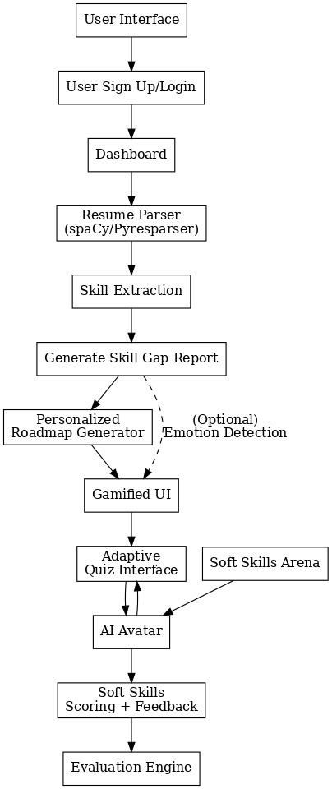
System Architecture, Functionalities and Design Diagram

Slide 9
Solution Alignment with Hexaware Objective
SkillArise aligns seamlessly with Hexaware objective of delivering personalized, AI-driven learning experiences that go beyond generic training models. Just as Hexaware proposes using intelligent agents (Profile, Assessment, Recommender, Tracker) to identify and close skill gaps, SkillArise uses AI resume parsing, adaptive quizzes, and personalized roadmaps to evaluate current skills, identify gaps, and guide learners effectively.
Both solutions focus on increasing engagement, efficiency, and targeted upskilling. SkillArise also extends Hexaware’s vision with AR-based soft skills mentoring and gamified progress tracking, enhancing employee development through immersive and personalized digital learning journeys.

Slide 10

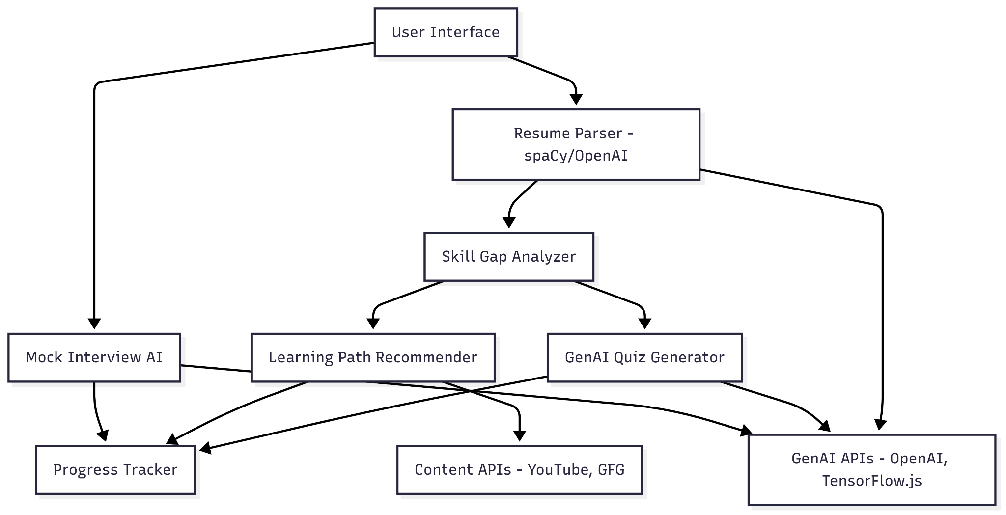
How it works
Functional Architecture

Slide 11
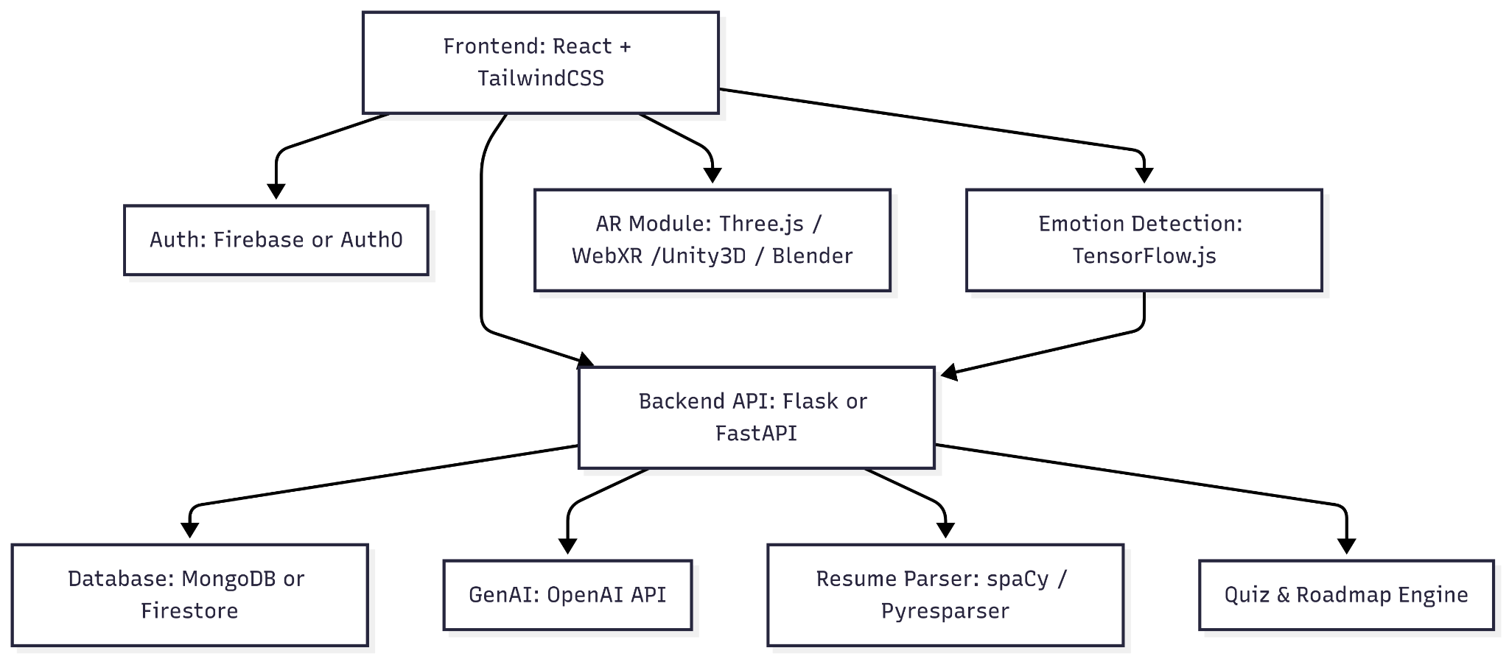
How it works
Technical Architecture

Slide 12
Innovation and Creativity
AI-powered Skill Gap Analysis: Compares user resumes with job requirements to identify missing skills.
Personalized Learning Roadmap: Tailors learning paths based on user goals and current skill levels.
Gamified Learning Experience: Features XP, badges, and progress tracking to boost engagement.
Resume to Roadmap Automation: Seamlessly generates a learning journey from uploaded resumes.
Performance Analytics: Offers insights into user growth, strengths, and areas for improvement.
Community-Based Learning (Guilds): Encourages collaboration, knowledge sharing, and friendly competition among users.
AR + AI Virtual Mentor: Conducts mock interviews and provides real-time feedback on soft skills.

Slide 13
Scalability, Performance and Security
SkillArise ensures growth and robustness through modular architecture, cloud-ready stack, database flexibility, and an API-driven design, allowing seamless scalability. Its performance is optimized with frontend optimization, asynchronous processing, efficient data handling, and adaptive logic for a smooth user experience. Security is maintained through strong authentication, data protection, API security, privacy compliance, and integrated AI & content safety mechanisms to ensure user trust and platform integrity.

Slide 14
Best practices and industry standards followed
Modular & Scalable:
Independent modules (parser, quiz, AR mentor) enable easy scaling and integration.
MVP-First Agile:
Builds core features first (resume, gap analysis, roadmap), then iterates.
AI/ML-Powered:
Uses NLP (spaCy, OpenAI) for parsing, skill mapping, and adaptive quizzes.
Gamified Learning:
Offers XP, badges, and personalized roadmaps to boost engagement.
AR Soft Skill Training:
AI avatar conducts mock interviews with emotion/facial feedback.

Slide 15
User Experience:
The journey begins as users upload their resume, allowing the system to instantly extract key skills. This forms the foundation for a tailored and efficient learning path.
Next, users engage in adaptive quizzes that match their current knowledge level. These smart assessments ensure each learner gets just the right challenge.
As they progress, a dynamic skill tree visually displays strengths, gaps, and improvements.This makes it easy to track development and stay motivated.
Based on the identified needs, curated learning paths are recommended from trusted sources.This ensures users learn exactly what they need, from quality
To keep learning engaging, lessons are gamified with XP, badges, and interactive content.
Finally,Soft skills are enhanced through AI-powered mock interviews. Users receive real-time feedback that builds confidence and communication abilities.

Slide 16
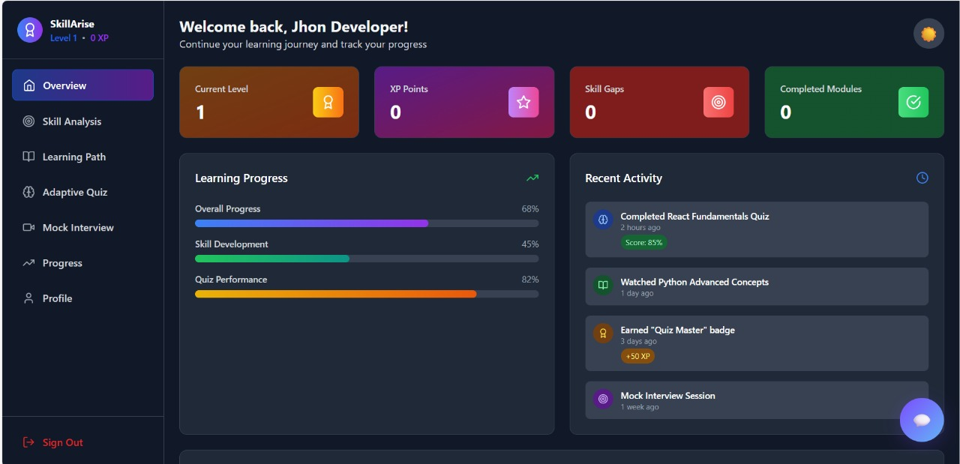
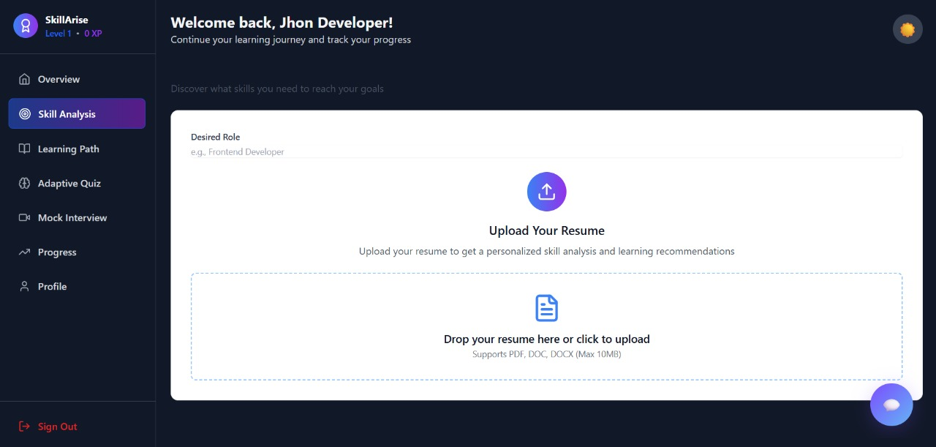
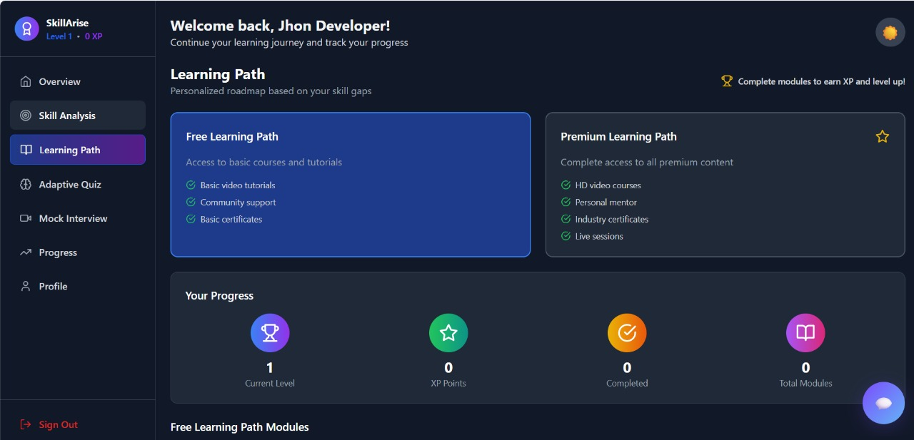
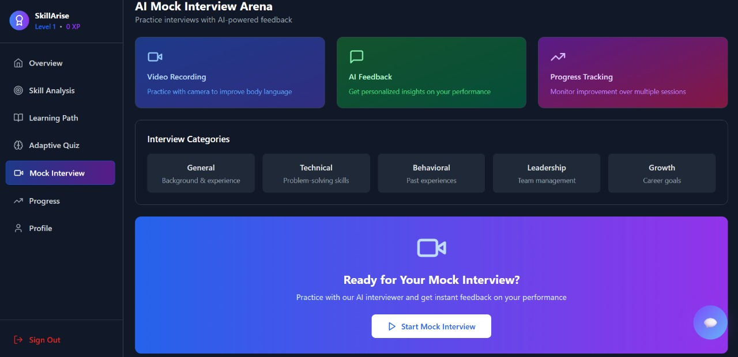
Console Output Details
GitHub Repo: https://github.com/Anharous/HexaWareHackathon.git

Slide 17
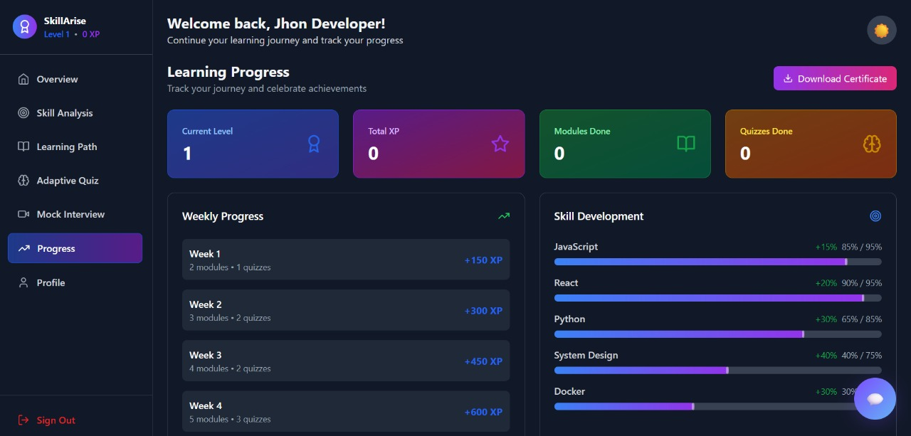
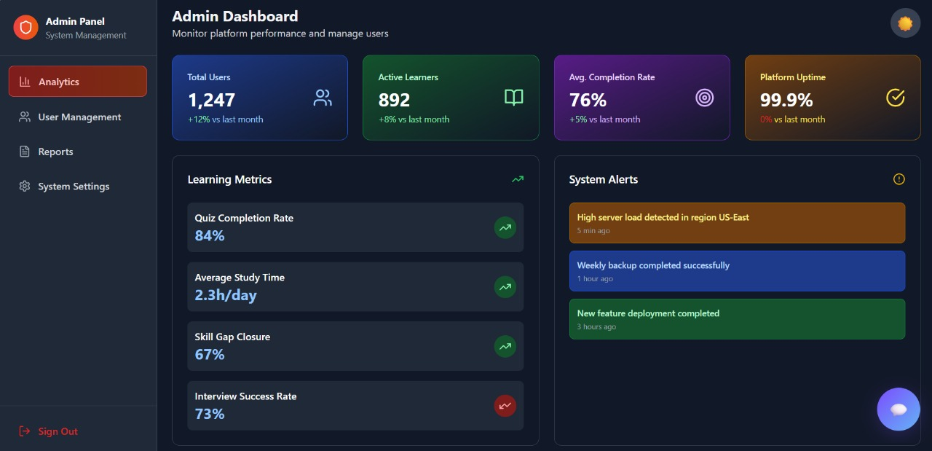
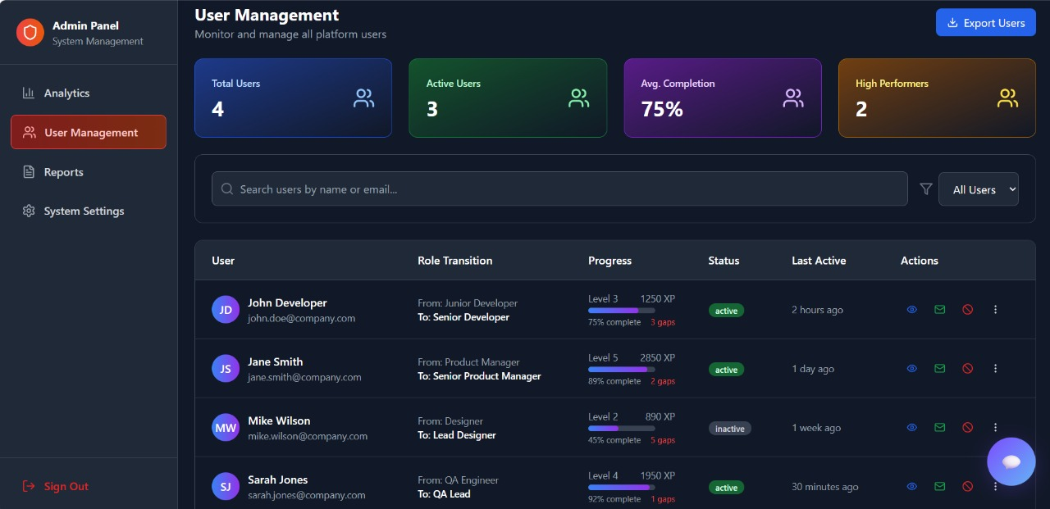
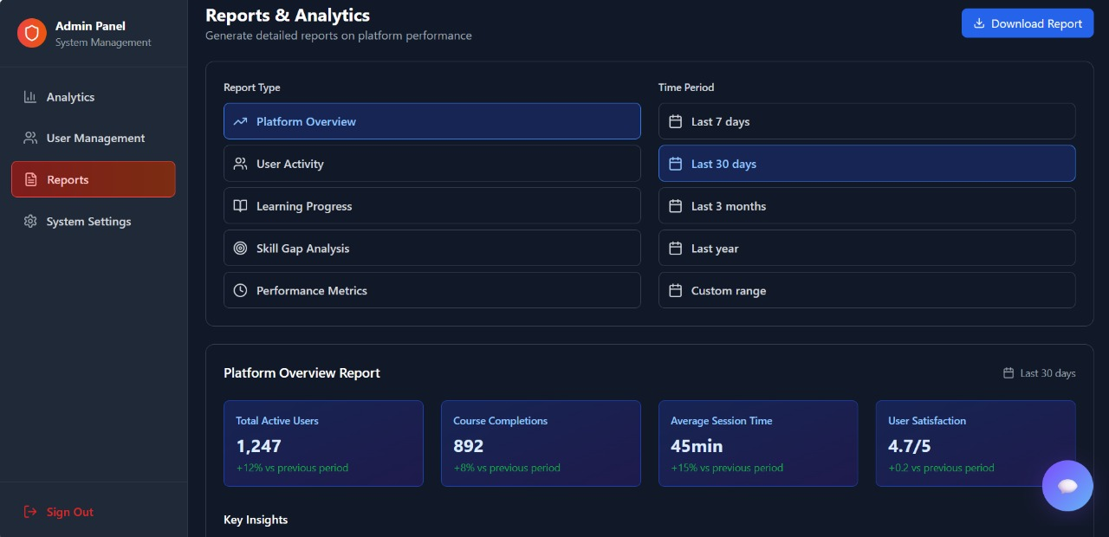

Slide 18

THANK YOU

